Slide 1
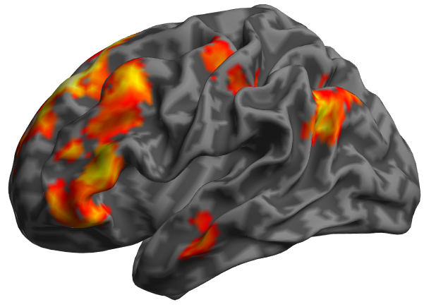
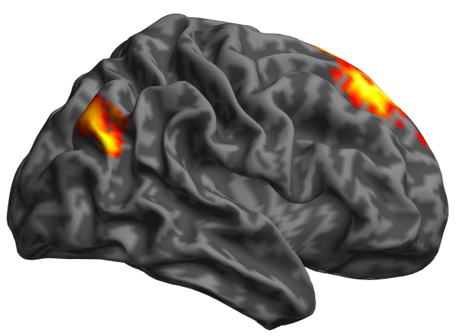

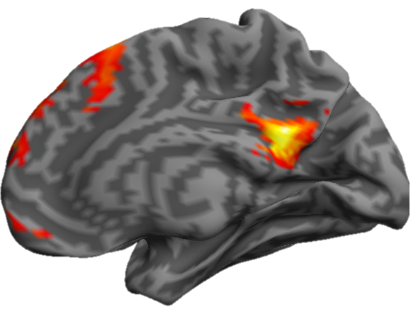
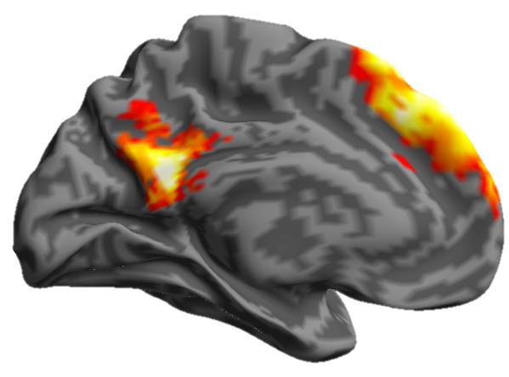
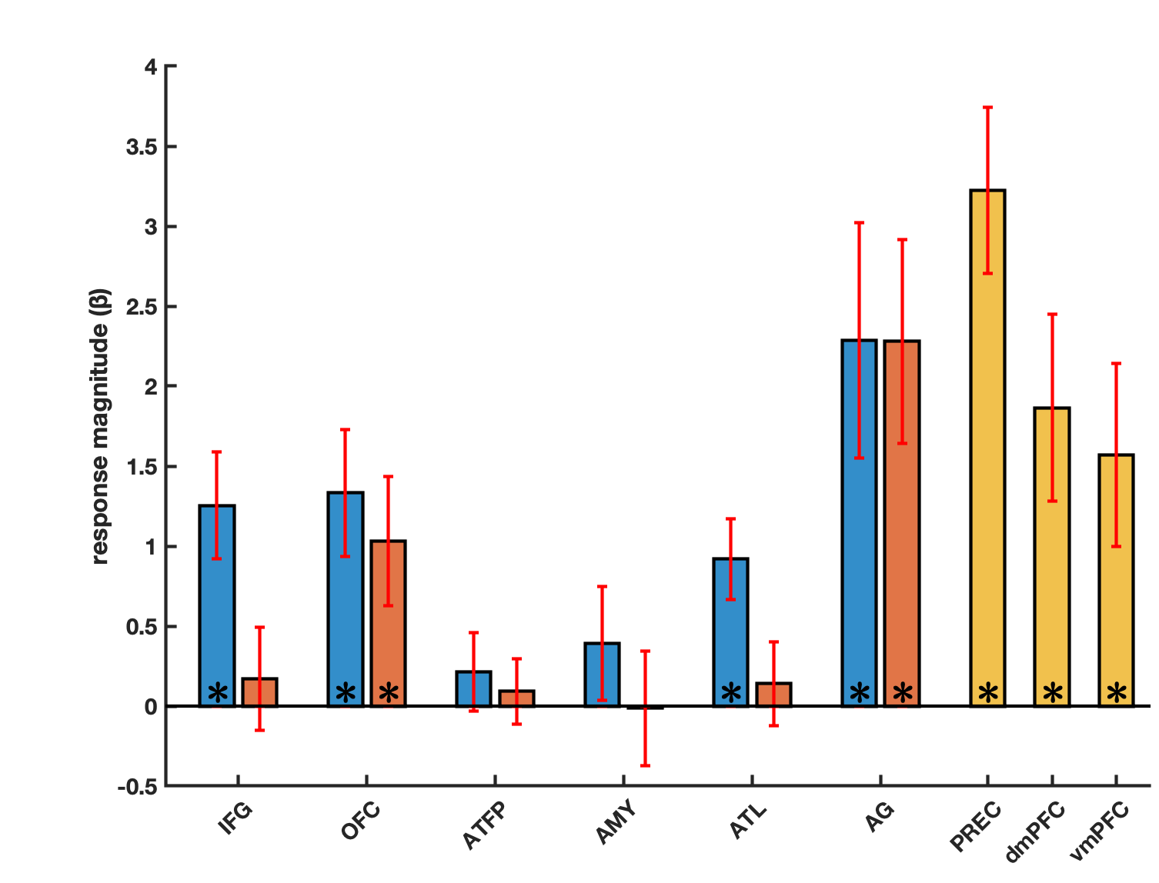
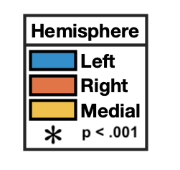
Person-knowledge > 1-back task
A)
B)
Voxel p < .001, Cluster p < .05 (FWE)
Hemisphere
Left
Right
Medial
p < .001

Slide 2
Person-knowledge taxonomy
Task similarity
Similarity models
Macro-Domain task clustering
Social
Physical
Episodic
Nominal
Biographical

Slide 3
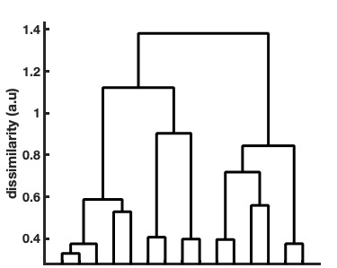
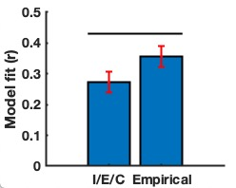
Hierarchical regional similarity
Model comparison procedure
Pattern similarity matrix
Pattern similarity
dendrogram
RSA
RSA
I/E/C model
Empirical model
Model fit
p = .001
Model fit
Model fit comparison
AG-L
IFG-L
OFC-L
AG-R
ATFP-R
ATL-L
IFG-R
AMY-L
OFC-R
AMY-R
PREC
ATFP-L
ATL-R
dmPFC
vmPFC

Slide 4
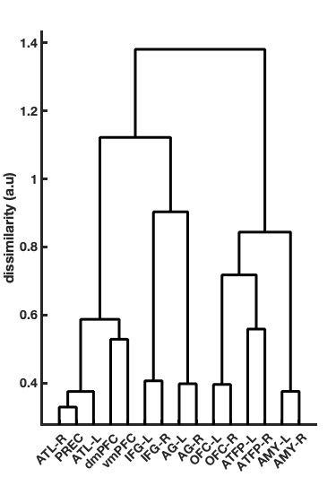
Hierarchical regional similarity
Model comparison procedure
Multi-dimensional scaling
Pattern similarity matrix
Regional similarity during name-reading
MDS
RSA
RSA
I/E/C model
Empirical model
MDS
Regional similarity during face-viewing
Model fit
p = .001
Model fit
Model fit comparison

